Slide 1
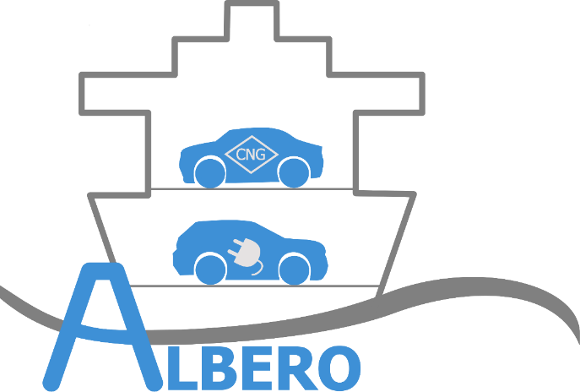
Damaged Li-Ion-Batteries - «the gas ghosts»
Dr. Dana Meißner
Institut für Sicherheitstechnik / Schiffssicherheit e.V., Rostock- Warnemünde
Conference on Fire Safety at Sea 14. 12. 2021

Slide 2
The Ghost of Oxygen
Often found statement in various media:
„ A battery fire releases oxygen, which feeds the fire itself.”
Lithium-ion battery fires are considered very difficult to fight. Extinguishing attempts with conventional inert agents are mostly unsuccessful, as lithium-ion cells generate the oxygen required for a fire themselves.
https://www.denios.de/unternehmen/denios-magazin/brandbekaempfung-bei-lithium-batteriebraenden
O₂
Dr. Dana Meißner, Conference on Fire Saftey at Sea, 14. 12. 2021

Slide 3
Gas release during thermal runaway
Main Components:
The composition of the gases depends on the specific cell chemistry, but the main components are always carbon monoxide CO, carbon dioxide CO₂, hydrogen H₂ and short-chain hydrocarbons.
During thermal runaway extra released oxygen has not been found in measurements (or only in very small concentrations!)
LiCoO₂ (LCO) Li-NiCoMn (NMC) LiFePO₄ (LFP)
Andrey W. Golubkov et. Al : Termal runaway experiments on consumer Li-ion batteries with metal-oxide and olivon-type cathodes, RSC Adv., 2014(4), 3633 - 3642 https://www.researchgate.net/publication/271378936_Thermal-runaway_experiments_on_consumer_Li-ion_batteries_with_metal-oxide_and_olivin-type_cathodes
Dr. Dana Meißner, Institut für Sicherheitstechnik / Schiffssicherheit e.V.

Slide 4
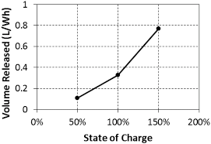
Gas release during thermal runaway
State of Charge:
The higher the State of Charge of the damaged battery, the more gas volume is released.
V. Somandepalli, K. Marr, Qu. Horn Quantification of Combustion Hazards of Thermal Runaway Failures in Lithium-Ion Batteries, SAE International Journal of Alternative Powertrains Vol. 3, No. 1 (May 2014), pp. 98-104
Dr. Dana Meißner, Institut für Sicherheitstechnik / Schiffssicherheit e.V.

Slide 5
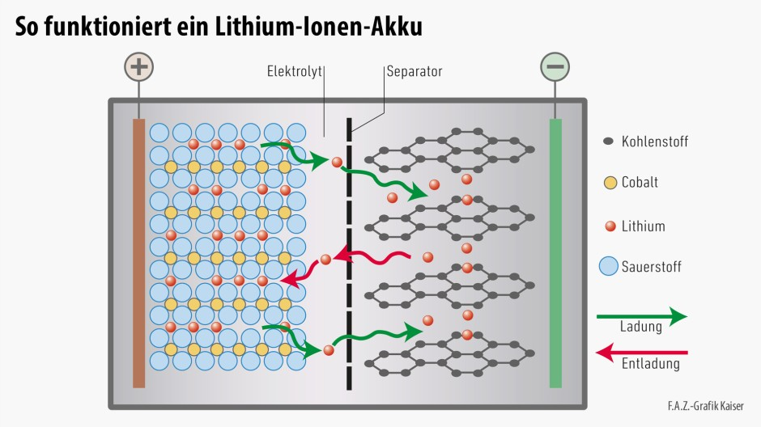
Gas release during thermal runaway
Working principle of a Li-Ion accumulator
Carbon
Cobalt
Lithium
Oxygen
charging
discharging
https://www.faz.net/aktuell/wissen/probleme-und-potentiale-der-lithium-ionen-technik-14030759/beim-aufladen-wandern-14039354.html
Dr. Dana Meißner, Institut für Sicherheitstechnik / Schiffssicherheit e.V.

Slide 6
Gas release during thermal runaway
Li-Metal-Oxide – Electrode
uncharged state
Li-Metal-Oxide – Electrode
charged state (most Li-Ions moved to graphite electrode)
Dr. Dana Meißner, Institut für Sicherheitstechnik / Schiffssicherheit e.V.

Slide 7
Gas release during thermal runaway
„Holes“ → Instable state!!!!
Heating
(thermal runaway):
+
Restructured cathode
released O₂
Restructuring process in cathode material to get a more stable state, thereby release of oxygen
Li-Metal-Oxide –Electrode
charged state (most Li-Ions moved to graphite electrode)
100 % SOC
F. Diaz, Y. Wang, R. Weyhe, B. Friedrich: Gas generation measurement and evaluation during mechanical processing and thermal treatment of spent Li-Ion batteries, Waste Management 84, 2019, 102 - 111
Dr. Dana Meißner, Institut für Sicherheitstechnik / Schiffssicherheit e.V.

Slide 8
Gas release during thermal runaway
C
C
production and release of
CO and CO₂ - gas
C
immediate exothermic reaction with carbon from electrolyte
fully consumption of released oxygen
released O₂
J. C. Hewson, S. P. Domino: Thermal runaway of lithium-ion batteries and hazards of abnormal thermal environments, thU.S. National Combustion Meeting Organized by the Central States Section of the Combustion Institute, May 17-20, 2015Cincinnati, Ohio
Dr. Dana Meißner, Institut für Sicherheitstechnik / Schiffssicherheit e.V.

Slide 9
Gas release during thermal runaway
1. The higher the state of charge the more „holes“ are in the cathode material.
2. The more holes – the more instable is the material → higher tendency to restructure,
restructuring processes start at lower temperatures
3. The more holes the more intense is the restructuring process, the more oxygen is released.
4. The more oxygen is released, the more electrolyte is oxydized.
5. The more electrolyte is oxydized, the more gases (CO, CO₂) are produced.
The higher the state of charge the higher is the amount of released gases.
(Other processes running parallel, but we just speak about the oxygen release.)
Dr. Dana Meißner, Institut für Sicherheitstechnik / Schiffssicherheit e.V.

Slide 10
The Ghost of Oxygen
Summary:
Oxygen is released but will not leave the cell.
It feeds the thermal runaway by producing heat inside by oxydation reactions.
Dr. Dana Meißner, Institut für Sicherheitstechnik / Schiffssicherheit e.V.

Slide 11
The Ghost of Hydrogen
Water is considered as the agent of choice, but recently the following statements have increased:
“Li-ion batteries should not be extinguished with water, as hydrogen is released in the process. Extinguishing work can create a risk of explosion. "
Hence, we should avoid to extinguish lithium battery fires with water. The primary reason is lithium burns in the air we breathe. And moreover reacts with water to form explosive hydrogen that may develop a chain reaction.
https://www.upsbatterycenter.com/blog/extinguish-lithium-battery-fires/ 04.10.2021
H₂
Dr. Dana Meißner, Institut für Sicherheitstechnik / Schiffssicherheit e.V.

Slide 12
Release of Hydrogen
Phases of hydrogen release in the event of an accident with Li-ion batteries
1
beginning of thermal runaway
2
during
thermal runaway
3
after extinguishing
(also: immerse the battery in water)
4
If intact batteries with open electrodes are flooded (e.g. in a warehouse)
Electrolysis
The released hydrogen burns during the fire.
Release of hydrogen from the graphite
electrodes
Internal electrolysis with the electrolyte, decomposition reactions
Reaction of water with Lithium in damaged battery cells;
Electrolysis processes at undamaged battery cells
Dr. Dana Meißner, Institut für Sicherheitstechnik / Schiffssicherheit e.V.

Slide 13
Release of Hydrogen
1
beginning of thermal runaway
2
during thermal runaway
3
after extinguishing
(also: immerse the battery in water)
Chance for early detection?!
1 Release of hydrogen at the beginning of the thermal runaway
In the cell electrolyte decomposition processes and electrolysis processes always take place to a certain extent, in which more and more atomic hydrogen is created over time, which can be stored in the graphite of the anode. At elevated temperatures, this atomic hydrogen is recombined into molecular hydrogen (H + H → H₂), releasing additional heat.
Hydrogen is released in this phase from the cell. The risk of releasing large amounts of additional hydrogen by using water to cool during this phase is low.
Problem rather: supplying an ignition source!
Dr. Dana Meißner, Institut für Sicherheitstechnik / Schiffssicherheit e.V.

Slide 14
Release of Hydrogen
The higher the number of charging cycles, the greater the amount of hydrogen released.
The amount released does not depend so much on the state of charge!
“The conducted experiments in ARC-calorimeter show that during cycling of lithium-ion cells …, there is accumulated hydrogen, which exists inside of graphite in atomic form. Upon cell heating up to a distinct temperature…the powerful exothermic reaction of recombination of atomic hydrogen … starts. An amount of energy released in this reaction is determined only by amount of accumulated hydrogen (i.e. by a number of charge/discharge cycles) and does not depend on SOC”
N. E. Galushkin et al. Mechanism of Thermal Runaway in Lithium-Ion Cells 2018 J. Electrochem. Soc.165,A1303
Dr. Dana Meißner, Institut für Sicherheitstechnik / Schiffssicherheit e.V.

Slide 15
Release of Hydrogen
1
Beginning of thermal runaway
2
during
thermal runaway
3
after extinguishing
(also: immerse the battery in water)
2 Release of hydrogen during thermal runaway
If the temperature continues to rise, the solid electrolyte interphase (SEI) or the separator is destroyed and an internal short circuit in the cell occurs. Various electrolysis and decomposition processes take place between the components of the cell, releasing hydrogen.
Hydrogen is released in this phase from the cell. The risk of releasing large amounts of additional hydrogen by using water to cool during this phase is low.
Problem rather: supplying an ignition source!
Dr. Dana Meißner, Institut für Sicherheitstechnik / Schiffssicherheit e.V.

Slide 16
Release of Hydrogen
1
beginning of thermal runaway
2
during
thermal runaway
3
after extinguishing
(also: immerse the battery in water)
Fire
As soon as the gases released from the battery (H₂, CO,...) have ignited, they burn to the respective oxidation products. Hydrogen burns to form water.
The use of water as an extinguishing agent during this phase is unproblematic with regard to the release of hydrogen.
Dr. Dana Meißner, Institut für Sicherheitstechnik / Schiffssicherheit e.V.

Slide 17
Release of Hydrogen
1
Beginning of thermal runaway
2
during
thermal runaway
3
after extinguishing
(also: immerse the battery in water)
3. Release of Hydrogen after extinguishing measures
If the battery has been so badly destroyed that water can come into contact with the metallic components (lithium) inside the battery, this can lead to a reaction:
Li + H₂O → LiOH + H₂
Process also when immersing entire battery modules / vehicles in water-filled containers.
In addition, electrolysis processes at remaining undamaged cells.
In closed rooms an explosive atmosphere can develop!
Dr. Dana Meißner, Institut für Sicherheitstechnik / Schiffssicherheit e.V.

Slide 18
Release of Hydrogen
Flooding of intact batteries with open electrodes (e.g. at storages)
4. Release of Hydrogen while flooding intact batteries
https://www.chemie.de/lexikon/Elektrolyse.html:
The formation of 1 g of hydrogen (approx. 11.2 liters of gas) from aqueous solution at a current of 1 A takes 26 hours and 48 minutes.
Process is dependent on the energy density, state of charge and the number of batteries stored. Will run faster in salt water! Can become problematic if it lasts for a longer period of time.
In closed rooms an explosive atmosphere can develop!
Dr. Dana Meißner, Institut für Sicherheitstechnik / Schiffssicherheit e.V.

Slide 19
The Ghost of Hydrogen
LIMITING OXYGEN CONCENTRATION of Hydrogen: 5 Vol %
SUMMARY:
before and during the fire
It is above all hydrogen which is released from the cell that supports the external combustion for a long time, as it still burns even with very low oxygen concentrations.
After fire / without fire
Hydrogen can be released from flooded batteries.
Dr. Dana Meißner, Institut für Sicherheitstechnik / Schiffssicherheit e.V.

Slide 20
The optimum suppressing agent
Oxygen promotes thermal runaway by producing heat in the cell, thereby spreading to neighboring cells
Hydrogen promotes thermal runaway by supporting the external fire, thereby spreading to other cells
_{H2}
O₂
Cooling to stop the exothermic processes in the cell. Water not really cold enough, consequential problems
Inerting to stop external fire
to <5% volume oxygen
Cold inert medium!!!
Dr. Dana Meißner, Institut für Sicherheitstechnik / Schiffssicherheit e.V.

Slide 21
Thank you for your attention!
www.alberoprojekt.de
Dr. Dana Meißner, Institut für Sicherheitstechnik / Schiffssicherheit e.V.

